Slide 1

EMPLOYEE ATTRITION ANALYSIS
DOMAIN: HR
NAME:MONICA MURUGESAN
ID:UMIP0622

Slide 2
STATEMENT
XYZ company which was established a few years back is facing around a 15% attrition rate for a couple of years. And it's majorly affecting the company in many aspects. In order to understand why employees are leaving the company and reduce the attrition rate XYZ company has approached an HR analytics consultancy for analyzing the data they have. You are playing the HR analyst role in this project and building a dashboard which can help the organization in making data-driven decisions.

Slide 3
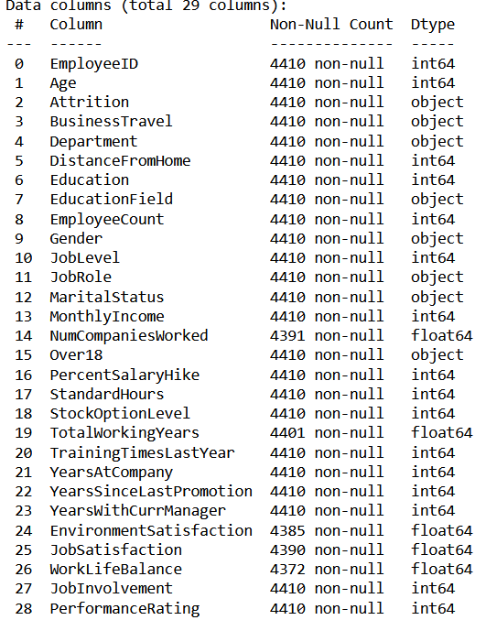
DATASET DETAILS

Slide 4
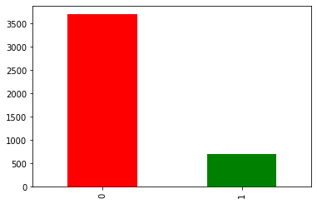
ATTRITION COUNT
'Yes’:1
'No':0

Slide 5
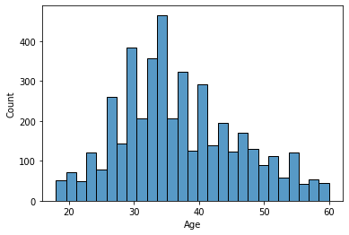
AGEWISE DISTRIBUTION

Slide 6
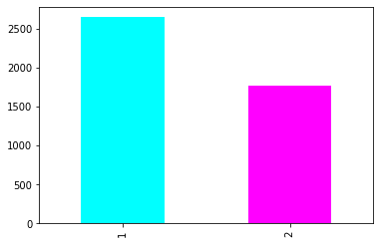
GENDER COUNT
'Female’:2
'Male':1

Slide 7
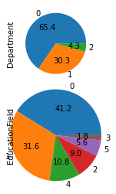
DEPARTMENT AND EDUCATIONFIELD
'Research & Development’:0
'Sales’:1
'Human Resources':2
'Life Sciences’:0
'Medical’:1
'Technical Degree’:2
'Human Resources’:3
'Marketing’:4
'Other':5

Slide 8
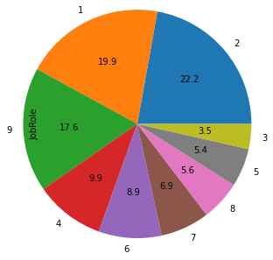
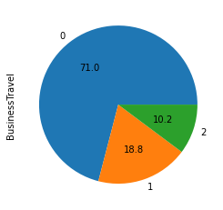
JOB ROLE AND BUSINESSTRAVEL
'Research Scientist’:1,
'Sales Executive’:2,
'Human Resources’:3,
'Manufacturing Director’:4,
'Research Director’:5,
'HealthcareRepresentative’:6,
'Manager':7,
'Sales Representative’:8,
'Laboratory Technician':9
'Travel_Rarely’:0,
'Travel_Frequently’:1,
'Non-Travel':2

Slide 9
JOB ROLE AND BUSINESSTRAVEL
'Research Scientist’:1,
'Sales Executive’:2,
'Human Resources’:3,
'Manufacturing Director’:4,
'Research Director’:5,
'HealthcareRepresentative’:6,
'Manager':7,
'Sales Representative’:8,
'Laboratory Technician':9
'Travel_Rarely’:0,
'Travel_Frequently’:1,
'Non-Travel':2

Slide 10
JOB ROLE AND BUSINESSTRAVEL
'Research Scientist’:1,
'Sales Executive’:2,
'Human Resources’:3,
'Manufacturing Director’:4,
'Research Director’:5,
'HealthcareRepresentative’:6,
'Manager':7,
'Sales Representative’:8,
'Laboratory Technician':9
'Travel_Rarely’:0,
'Travel_Frequently’:1,
'Non-Travel':2

